Slide 1
DESIGN AND IMPLEMENTATION OF A MOBILE-BASED ARCHIVAL AND RETRIEVAL OF MISSING OBJECTS APPLICATION USING IMAGE MATCHING
task 6: database design and implementation
Group one

Slide 2
OUTLINE
INTRODUCTION
DATABASE DESING
IMPLEMENTATION
CONCLUSION

Slide 3
I. INTRODUCTION
OVERVIEW

Slide 4
Factors considered
Functional
Non Functional

Slide 5
Functional Considerations
User Registration and authentication
Image upload and capture
Image matching
Notifications
Item search and retrieval
Data management and manipulation

Slide 6
Non Functional Considerations
Scalability
Security
Availability
Maintainability
Performance
Compliance

Slide 7
II. DESIGN

Slide 8
Database design
conceptual design
Logical design

Slide 9
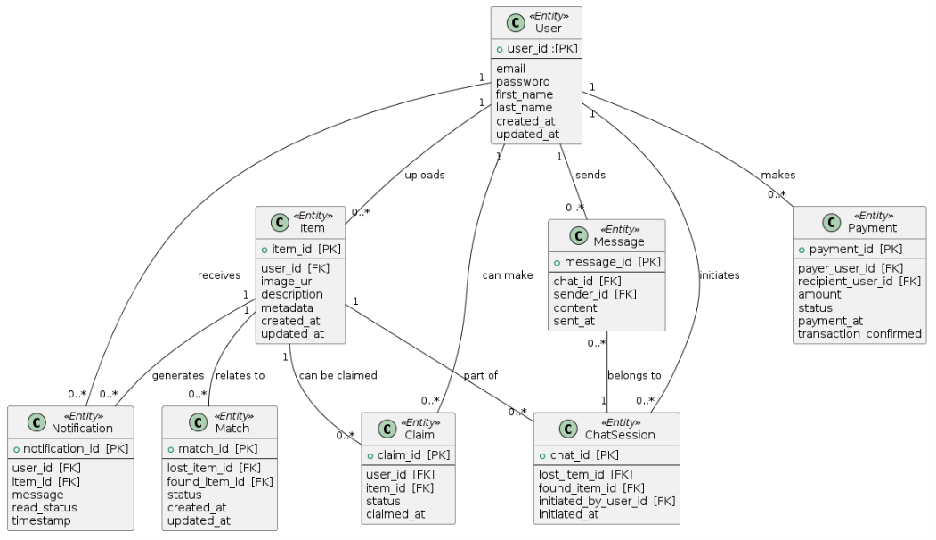
Conceptual design : Relational shema

Slide 10
2. Logical design
Analyzing Entities and relationships
Normalization

Slide 11
II. IMPLEMENTATION

Slide 12
methodology
Choice of technologies
Setting up environments
Code implementation
Testing
Security

Slide 13
Choice of technologies
Mongo DB
Firebase storage (image storage)

Slide 14
Setting up environment
Mongo DB
Create account
Access dashboard
Create cluster, database, collection
Get connection string
Use String in code

Slide 15
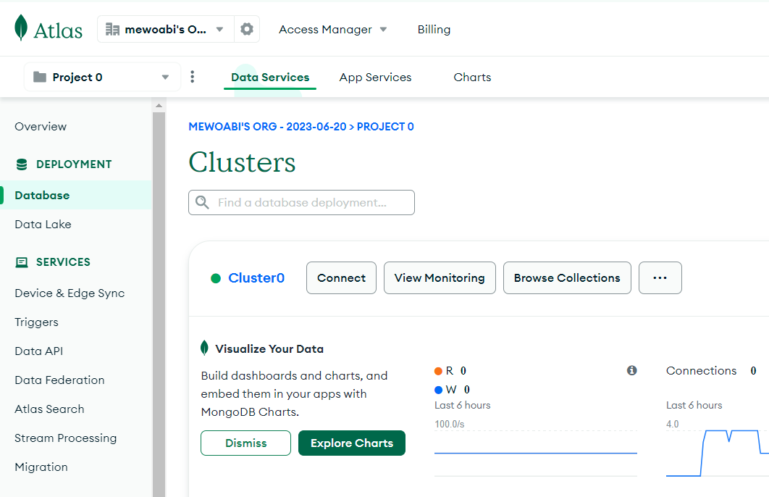
Dashboard: clusters

Slide 16
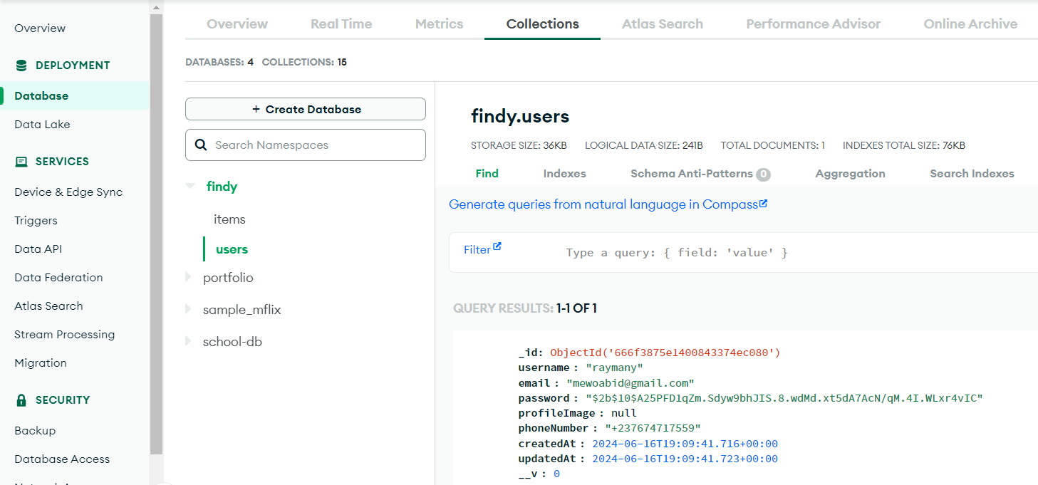
Dashboard: clusters > database > collections

Slide 17
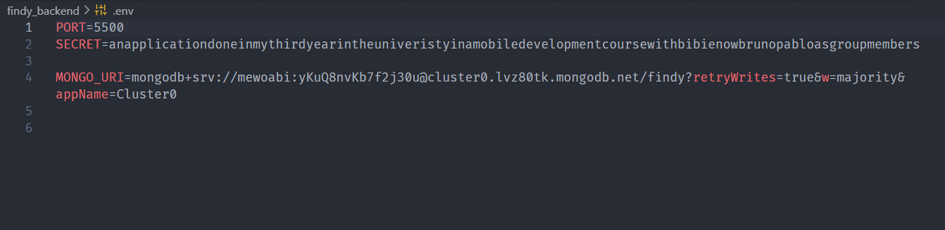
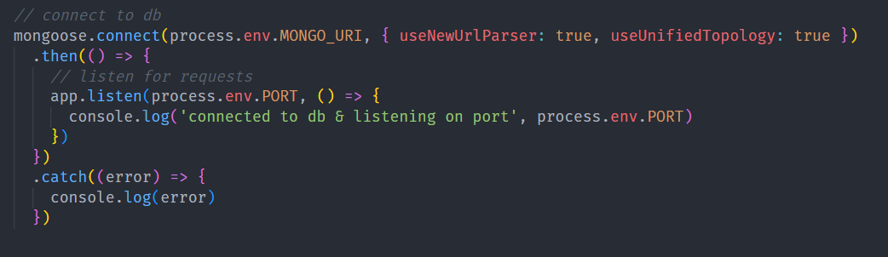
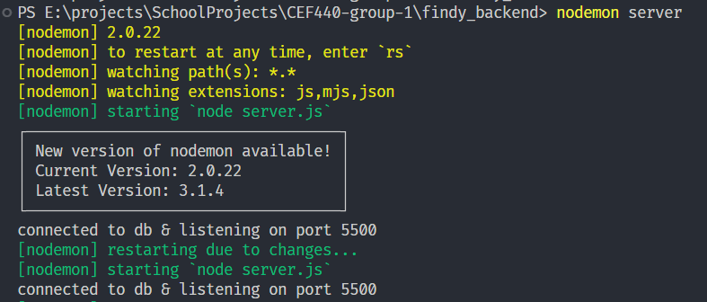
Code: connection string and usage

Slide 18
Setting up environment
Firebase
Create account
Access console
Create project
Choose storage service
Get the config snippet
Use snippet code
Install dependencies

Slide 19
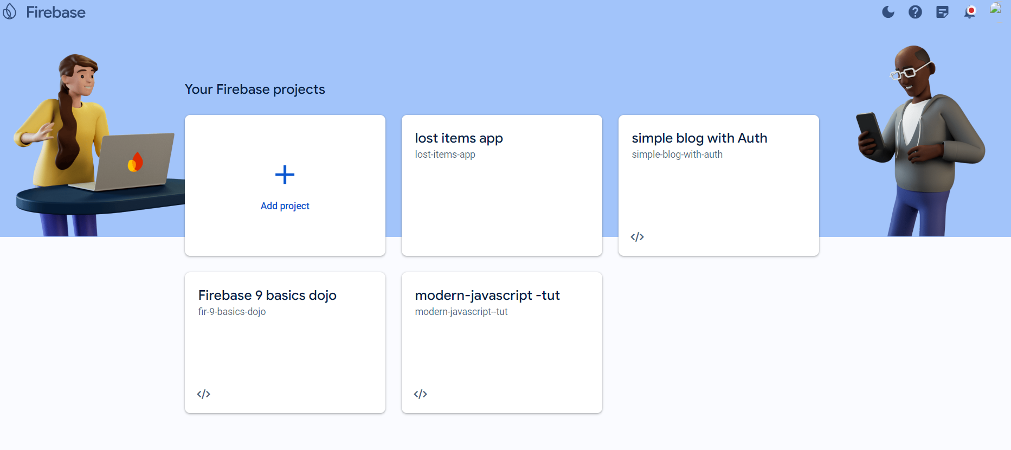
Console: create new project

Slide 20
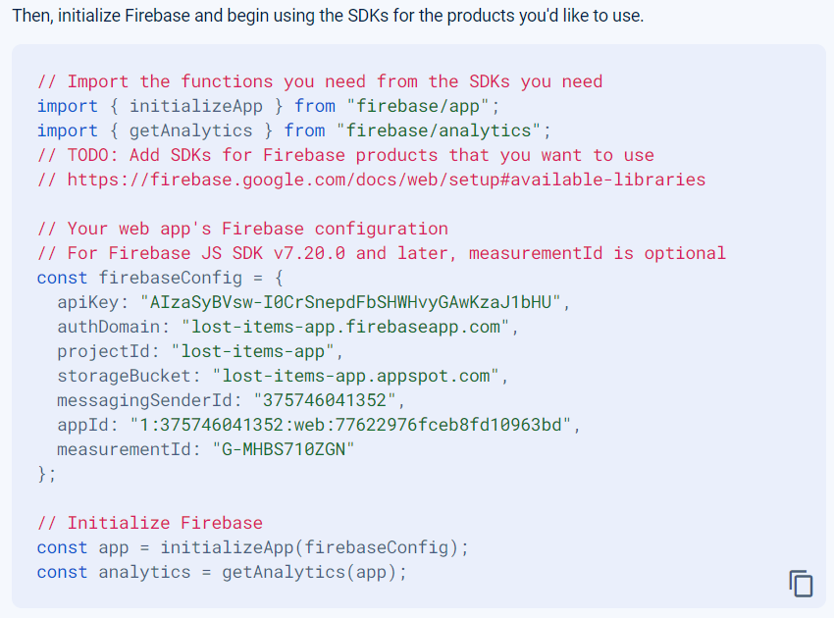
Config snippet

Slide 21
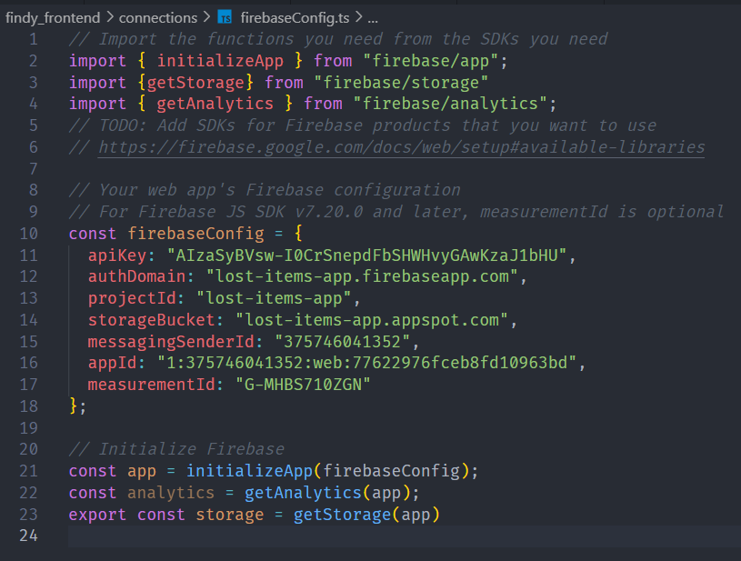
Config snippet

Slide 22
Code Implementation
Project Organization
Models
Controllers
Routes
Api Exposure

Slide 23
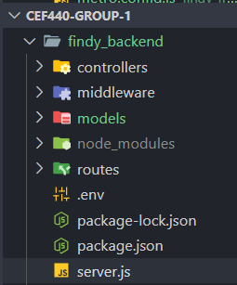
Project Structure

Slide 24
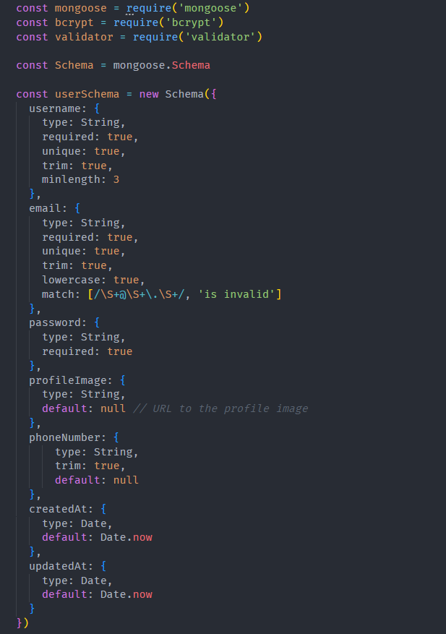


Model: user model

Slide 25
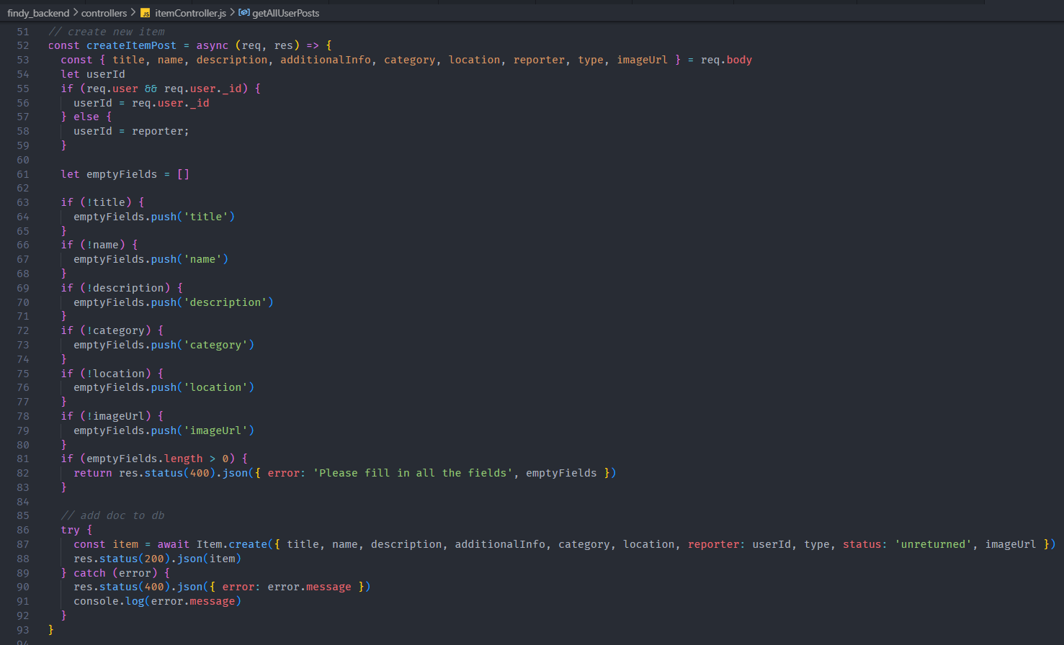
Controller: create Item method

Slide 26
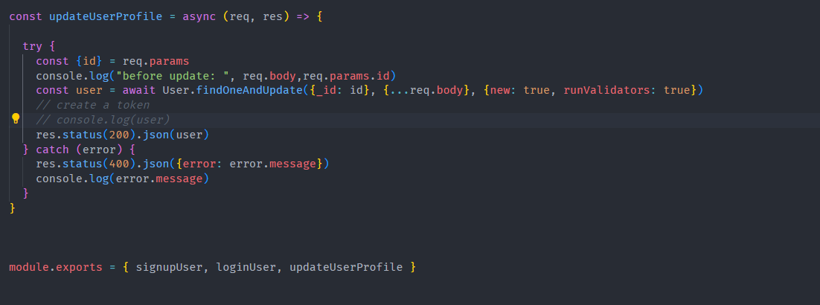
Controller: update user profile: function exports

Slide 27
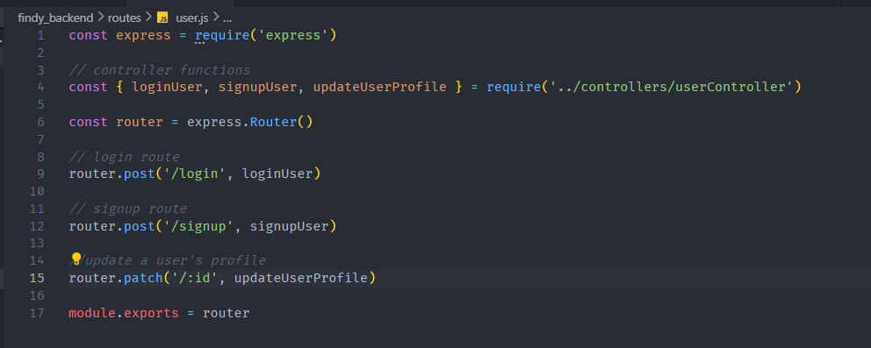
Routes: user routes

Slide 28
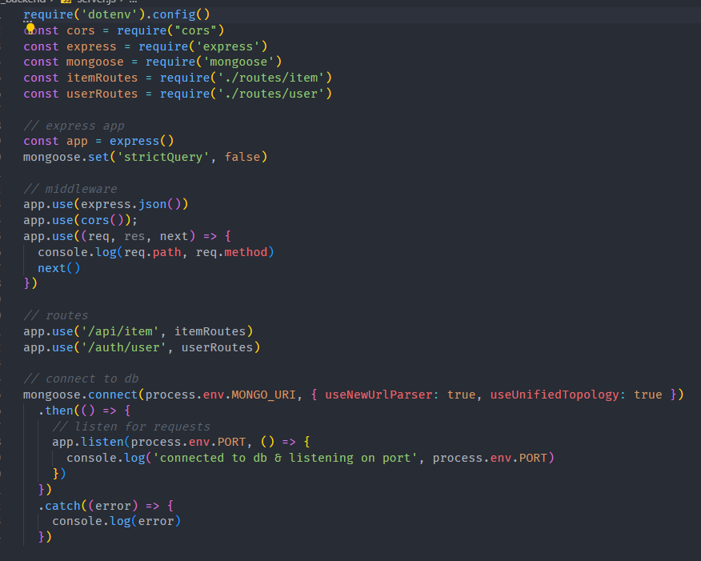
Routes: user routes

Slide 29
Testing
Mongo DB: Postman
Firebase : Expo-Go

Slide 30
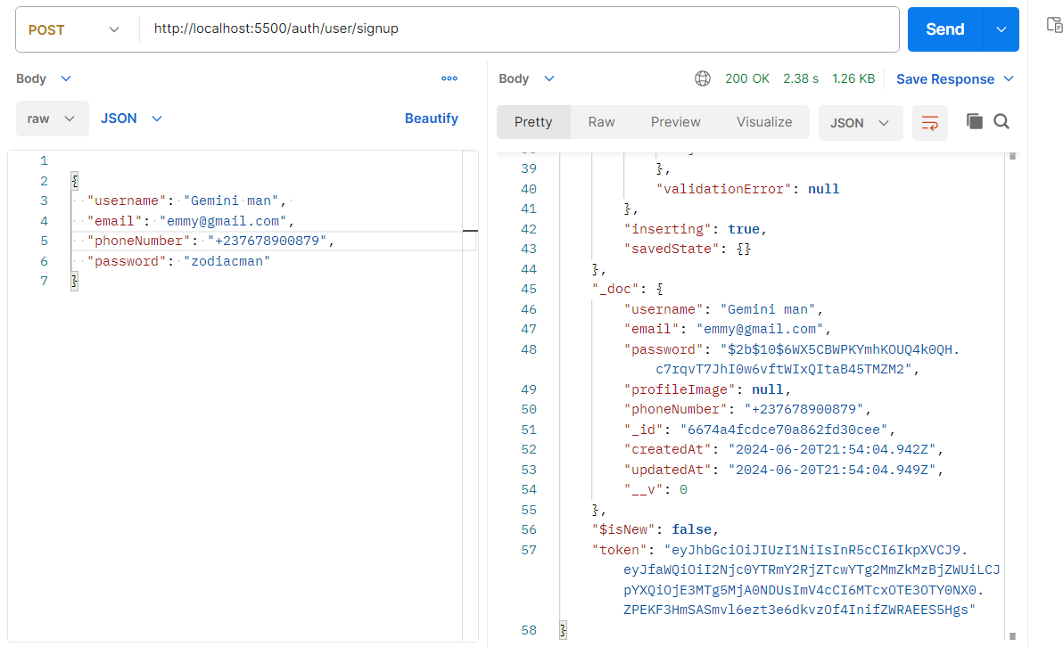
Postman: Signup user

Slide 31
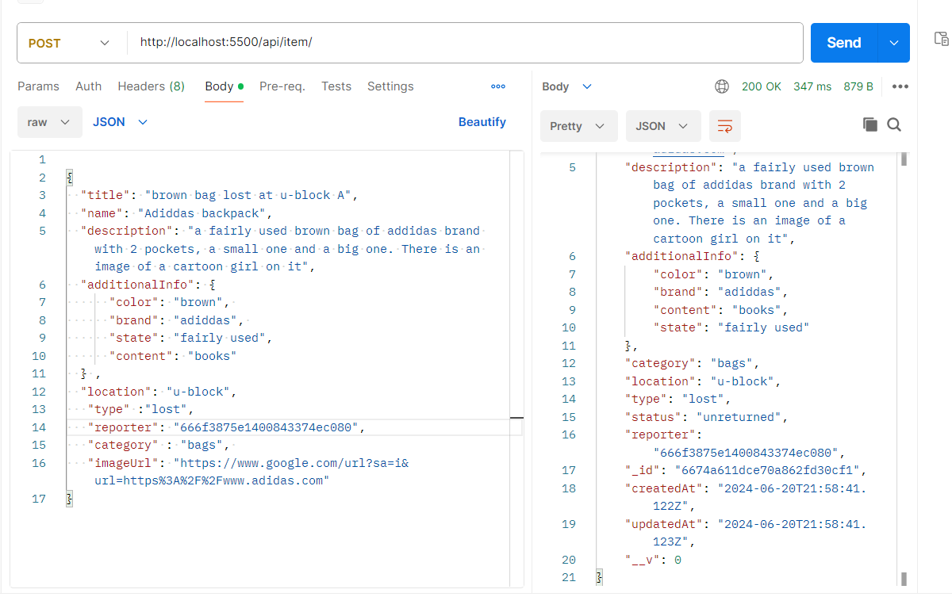
Postman: create Item Post (reporting an item)

Slide 32
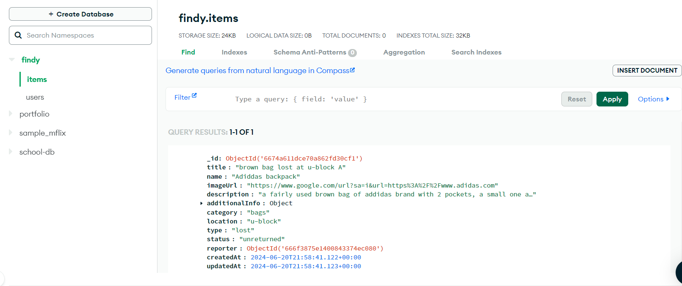
Confirming MongoDB atlas for tested records

Slide 33
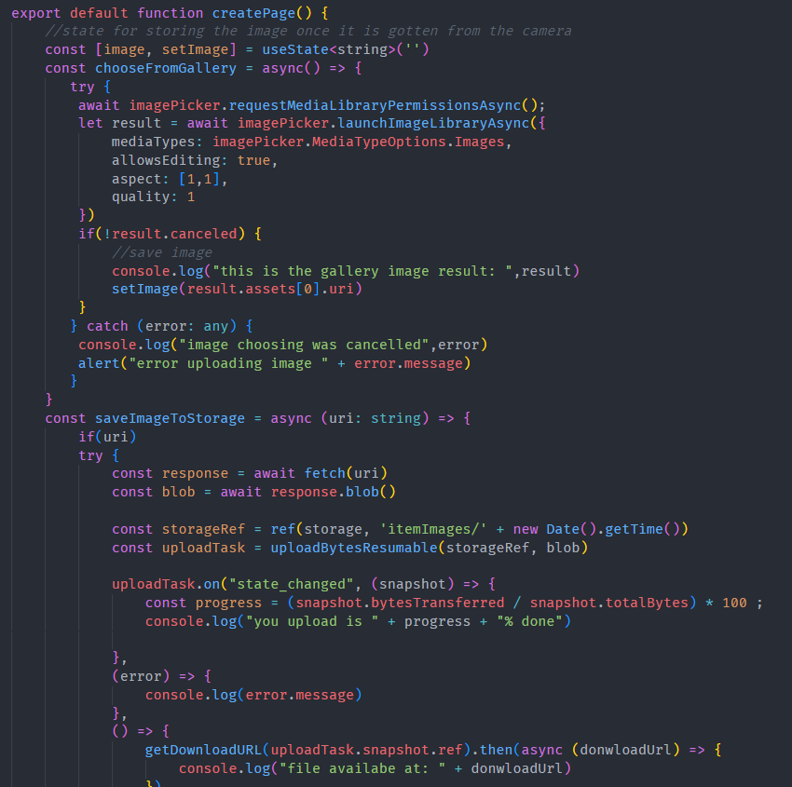
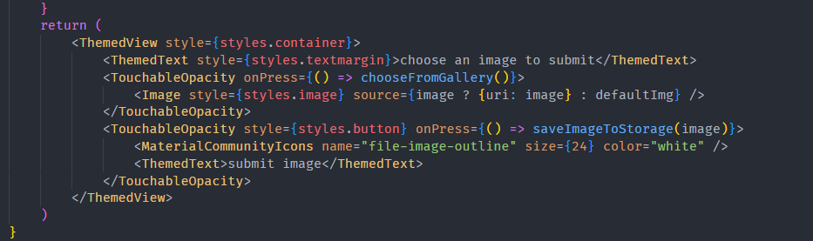
Firebase Test code

Slide 34
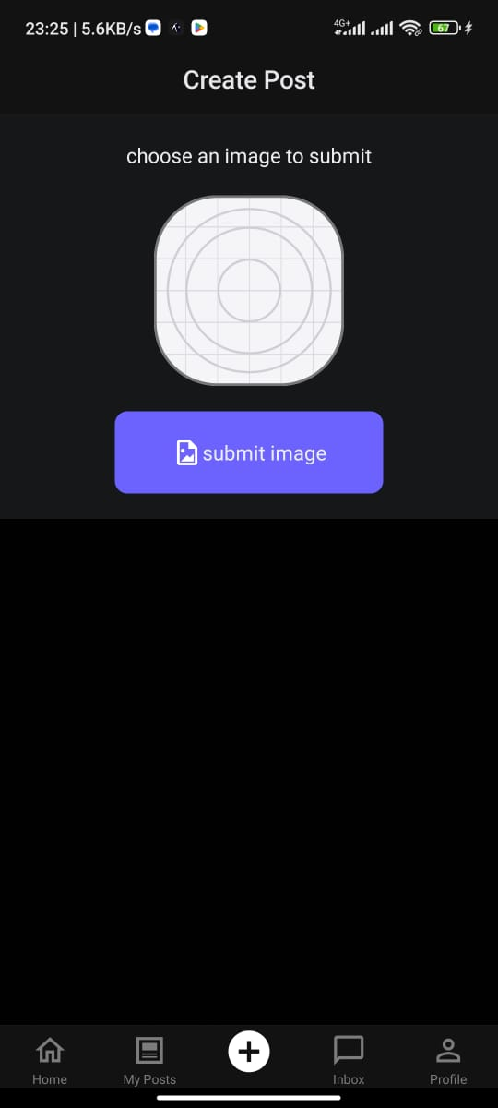
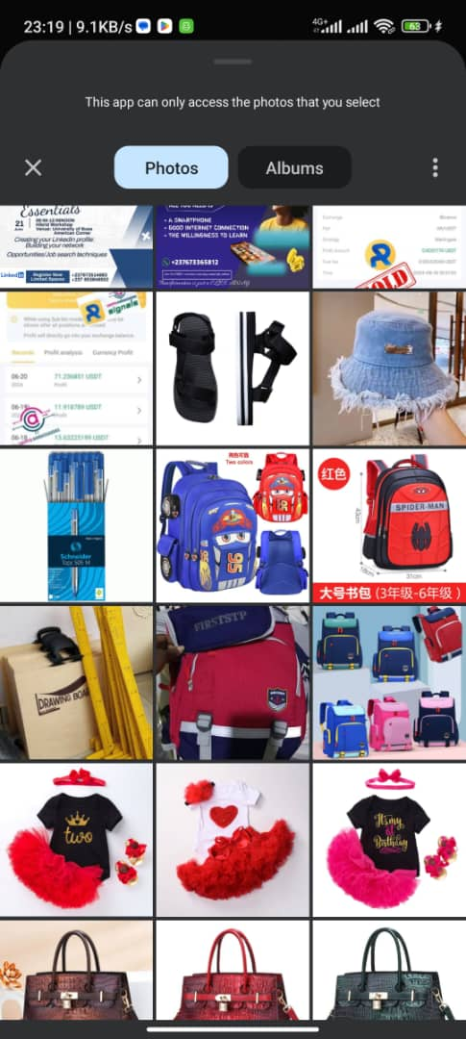
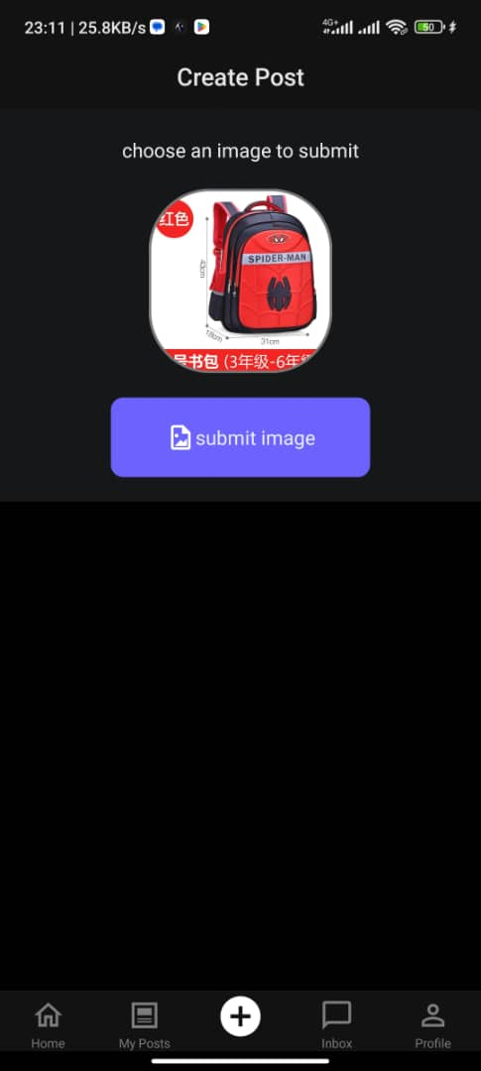
Test Interface and process

Slide 35
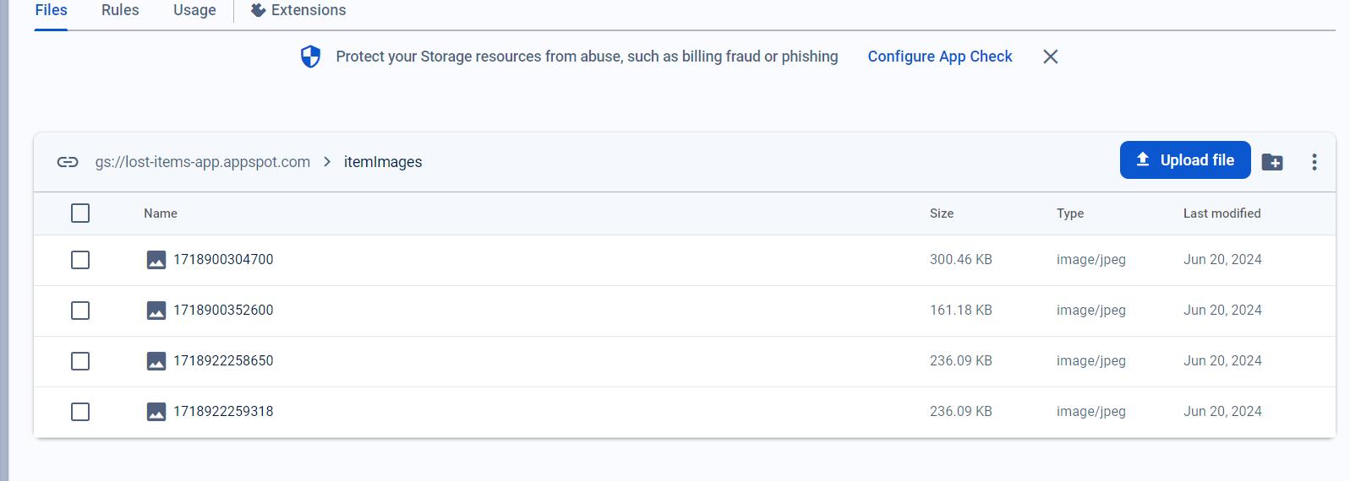
Confirming saved records on firebase storage

Slide 36
Security
Middleware Interception

Slide 37
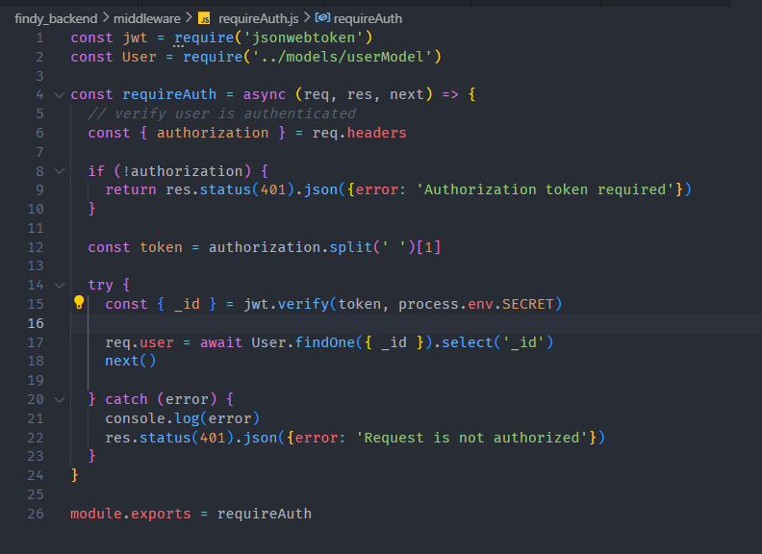
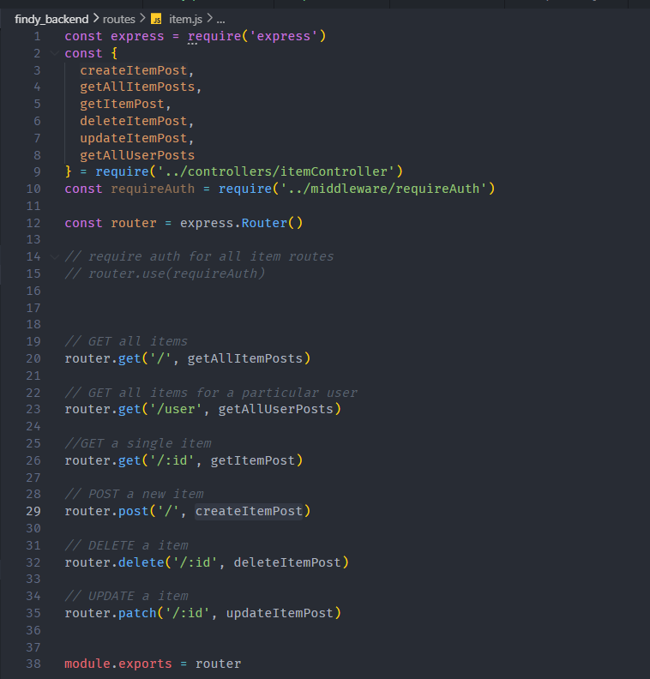
Securing endpoints using middleware

Slide 38
Iv . Conclusion

